Slide 1
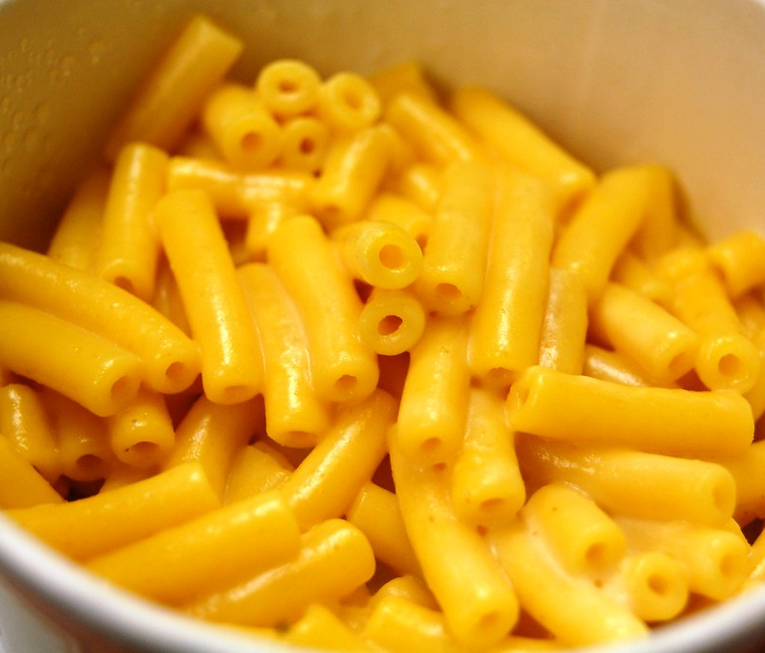

Novice: Jimmy
Quote: "My mom doesn't even need recipes to cook. How can I get there?"
Age: 20
Has made instant pasta before, but not much experience cooking.
Might need help with times/temperatures.
Doesn't know cutting techniques.
Finds recipes confusing, specially measuring.
Makes mistakes often when cooking.
Goals:
Learn how to meal prep.
Cook food for himself.
Learn cooking techniques.
Favorite dish: Mom's chicken parmesan.

Slide 2
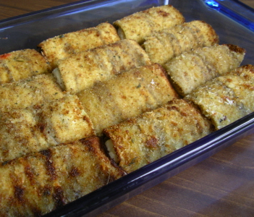

Skilled Home Chef: Anastasia
Quote: "You should really try my eggplant rollatini"
Age: 32
Businesswoman, lives by herself. Cooking is a big hobby.
Not the kind of person who likes to be told what to do.
Great cook, but very messy.
Easily gets distracted when cooking,
there is always a meeting somewhere.
Goals:
She is looking for advice, fine touches.
Learn how to integrate more herbs into her dishes
Try making new recipes to expand her repertoire
Would like a way to make sure she's not missing anything
Favorite dish: eggplant rollatini.

Slide 3
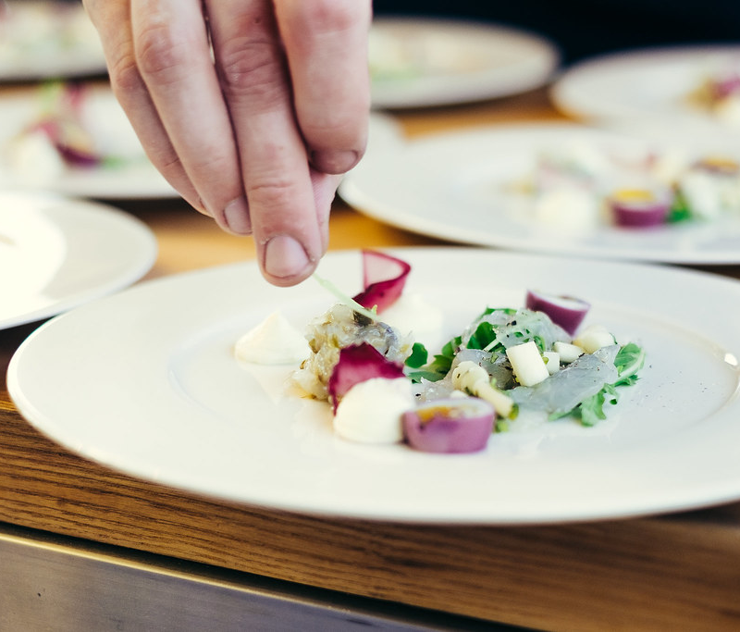
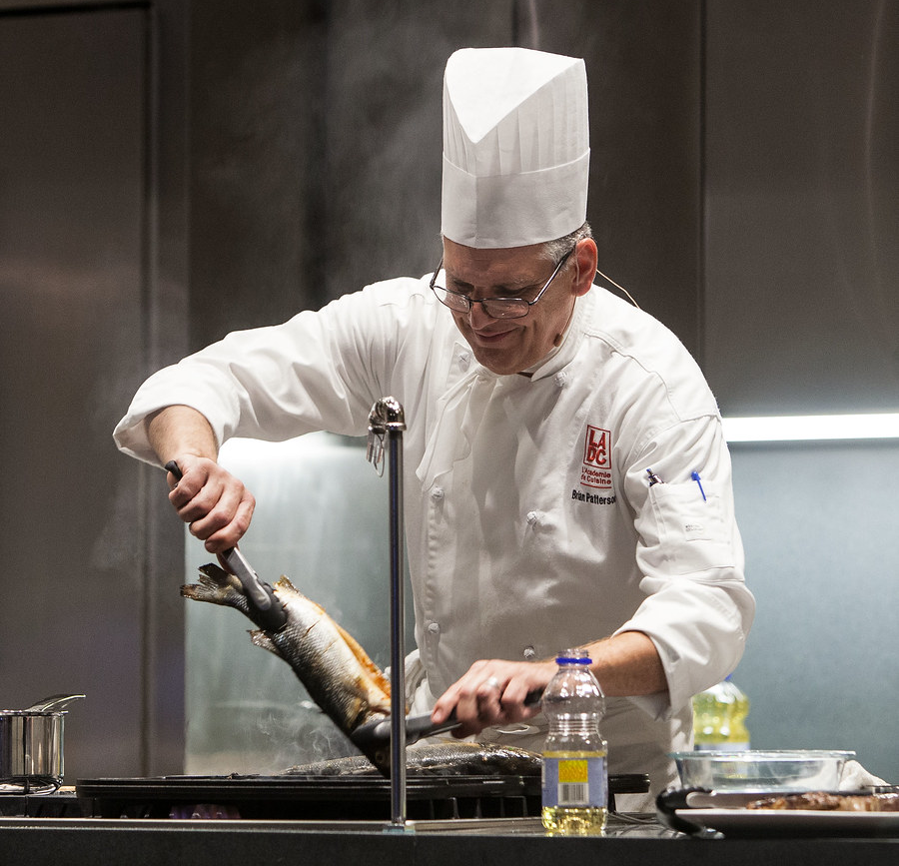
Professional Chef: Luca
Quote: "Michelin stars are overrated!"
Name: Pierre-Luc (but just call him Luca)
Age: 51
Chef at a local high-end restaurant
Been working there for quite some time.
Always stressed when it comes to rush hour.
Has trouble sometimes managing multiple recipes in addition to other chefs.
Goals:
Help with cooking several dishes at the same time.
Dealing with high stress kitchen environment.
Making sure dishes go out to customers in time.
Favorite dish: Cail Bruich dish - West coast crab, raw Orkney scallop, Exmoor caviar

Slide 4

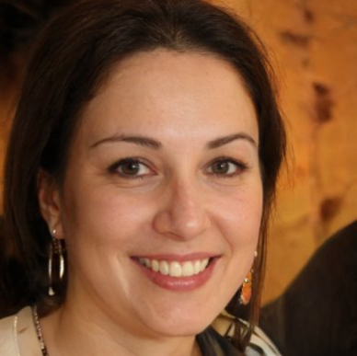
Interested Research Collaborator: Dr. Maria Gonzales
Favorite quote: "Problem-solving leaders have one thing in common: a faith that there's always a better way."
Age: 41
Professor at UC Davis
Research focus: computer vision and ML.
Dislikes reinventing the wheel.
Always looking for tools and resources that help her do better research.
Goals:
Contribute to projects while learning in the process.
Getting repeatable and reliable results in a timely manner.
Create solutions that can be shared, understood and reutilized by other teams around the globe.

Slide 5
Dr. Gonzales' Scenario
Dr. Gonzales just attended a DARPA meeting and is interested in contributing to the Florida team's work.
She is initially nervous, since collaborating with other teams and integrating software systems may sometimes be challenging.
Her team has developed an activity and object recognition system for common actions, food and instruments used by chefs when cooking, without the use of markers.
She contacts the Florida team, and they share their public repository with both code and system documentation.
Her team can understand most of the system architecture and design from the documentation. Florida team follows up with a couple of meetings to coordinate and straighten things up.
They learn that the publicly available Microsoft PSI framework forms the backbone of the ENKIx system, and that all data is formatted and passed into the PSI pipeline following standard guidelines.
They create a connector class in the ENKIx system that interfaces with their existing recognition system and converts the data to the PSI format successfully.
They contribute their code back to the ENKIx public repository and the Florida team reviews and integrates it into the main solution.
Now, with the new module alternative, any other piece within the ENKIx system has access to the data stream from Dr. Gonzales' system.
The Florida team can now easily switch between different object/action recognition systems, adding value to the ENKIx project.

Slide 6
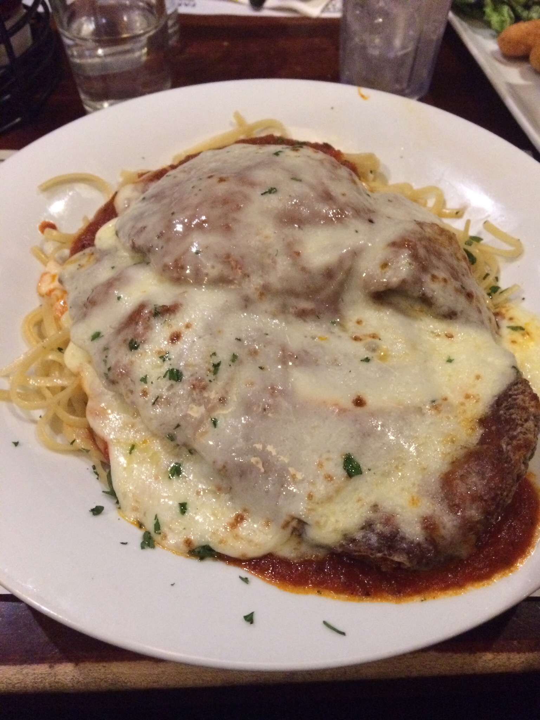
SCENARIO 1 (1/6) Jimmy Prepares to Cook Dinner
Jimmy just got home from classes and is hungry for some chicken parmesan, his favorite.
He doesn't have much experience cooking, so the system would be of great help to him.
He puts on the headset and asks it to pull up his mom's recipe for chicken parm.
The headset displays the list of ingredients that he needs.
Jimmy heads to his fridge.
The headset highlights each of the ingredients in the fridge and he quickly takes them out.
Now Jimmy has all the ingredients on his counter.
The headset then tells him what utensils he needs
Jimmy looks around his kitchen and the headset helps him identify the tools he needs (like a teaspoon vs. a tablespoon) so he doesn't grab the wrong ones
Now Jimmy is ready to begin prep!
Notes:
We assume that Jimmy has EVERY ingredient and EVERY right tool he needs.
We assume he can produce the right recipe (mom's chicken parm).

Slide 7
SCENARIO 1 (2/6) Jimmy Preps the Breading (Eggs)
The headset tells Jimmy to start with preparing the breading (a subtask).
Jimmy sees the ingredients and tools (like bowls) he needs to use to make the breading and he sets them in front to focus on.
The headset sees that he has all the ingredients and tools ready and asks Jimmy if he's ready to start.
Jimmy says yes, and the system gives him the first step, which is to crack the eggs into a bowl.
Jimmy is unsure of the best way to crack eggs, so he asks the system.
The system shows a quick video on how to do this.
Jimmy follows the example as best as he can and gets both eggs in a bowl.
Now the system tells Jimmy to whisk the eggs. Jimmy doesn't know how to do this either, so the system pulls up an animation showing how it is done.
The system sees that the step is done, gives Jimmy some praise, and then explains the next step (which is to prep the flour and breadcrumbs mixed with parmesan).
Notes:
Assuming we want to get all the materials and prep ready first before cooking (like starting off with three bowls instead of grabbing a bowl each time)

Slide 8
SCENARIO 1 (3/6) Jimmy Preps the Breading (Flour)
Now the system asks Jimmy to get another bowl
He looks around and the two other bowls are highlighted (NOT the one with the eggs in it)
He grabs one and then says "Ok I got a bowl"
The system recognizes that and tells him that he needs 2 cups of flour, highlighting both the bag of flour and the measuring cup
This should be easy enough. Jimmy scoops a cup of flour and gets ready to put it in the bowl.
But wait! It's too much flour, so the system quickly tells him to level off the cup so that it's even on top
Jimmy does so and asks the system, "Does this look right?" The system confirms and Jimmy dumps the flour into the bowl.
"Okay, what's next?" Jimmy asks, forgetting the second cup of flour. The system highlights that he only has 1 out of 2 cups of flour in the bowl and that he needs to add a second cup
Jimmy does so and the system says "Ok great. Now let's move on to the breadcrumbs"
The system goes over similar steps as with the flour.
Notes:
Assuming we want to get all the materials and prep ready first before cooking (like starting off with three bowls instead of grabbing a bowl each time)

Slide 9
SCENARIO 1 (4/6) Jimmy Preps the Chicken
Now the system tells Jimmy that he's done with the breading prep and is ready to tackle the chicken. The system asks Jimmy if he's ready to continue. Jimmy nods.
The system recognizes that now would be a good time to start preheating the oven based on how long it took him to do the other prep.
The system tells Jimmy to preheat the oven by highlighting the buttons and telling/showing him the proper temperature. Once it is set, the system tells Jimmy he can start working on the chicken again.
The system highlights the chicken on the counter and asks Jimmy to put it on the counter.
Once Jimmy does so, the system asks him to season the chicken with salt and pepper (highlighting both on the counter)
Jimmy grabs the salt shaker and gets ready to drown the chicken in salt.
The system realizes that Jimmy probably doesn't know how much to season so quickly tells him to be careful! "You don't want too much salt and pepper, just a sprinkle on both sides." The system shows a quick video demonstrating this.
Jimmy gives it a shot and asks, "Like this?" The system responds with "Yes, that's good!"
Jimmy is able to finish seasoning the chicken, repeating the steps with the other breasts.
Notes:
Assuming we want to get all the materials and prep ready first before cooking (like starting off with three bowls instead of grabbing a bowl each time)

Slide 10
SCENARIO 1 (5/6) Jimmy Breads the Chicken
The system tells Jimmy that it's time to bread the chicken, and then automatically gives him a quick overview by showing him it's a three-step process (flour, eggs, breadcrumbs) before asking him if he's ready.
The system then asks Jimmy to start with the first breast, covering both sides with flour. Jimmy does so and the system recognizes that and proceeds.
The system then tells Jimmy to dredge the chicken in the eggs, which Jimmy does.
Then the system has Jimmy put the chicken in the breadcrumb mixture and cover both sides. The system then asks Jimmy to repeat these steps for the other breasts, being more hands-off and only visually showing the steps without guiding him through.
However, Jimmy doesn't fully cover the next breast in flour, so the system quickly tells him to make sure it is fully covered before proceeding.
With the system's help, Jimmy is able to finish preparing the chicken
Notes:
Assuming we want to get all the materials and prep ready first before cooking (like starting off with three bowls instead of grabbing a bowl each time)

Slide 11
SCENARIO 1 (6/6) Jimmy Cooks the Chicken
Now it's time to fry the chicken in a pan. Jimmy thinks he has this step down, so he grabs a pan, fills it with oil and puts it on high heat.
The system realizes that this could cause smoke or burn the chicken, and tells Jimmy to turn the heat down to medium-high.
The system now asks Jimmy to fry the chicken in the pan for two minutes on each side. Jimmy puts the chicken in, and the system automatically starts a timer for two minutes
Two minutes later, the system tells Jimmy it's time to flip, and Jimmy does so, which initiates another two minute timer
Now that the step is done, Jimmy takes each chicken breast and puts it in a baking pan (he's seen his mother do this step). But he forgot to turn off the heat! The system alerts him to turn off the stove and remove the pan (it tells him a good place to put it)
The oven finishes preheating and the system asks Jimmy to put the baking pan in and bake for 15 minutes. As Jimmy closes the oven door, the system begins the timer.
15 minutes later, Jimmy grabs an oven mitt and pulls the baking pan out. The system gives him a good place to put the hot pan on the stovetop.
The system recognizes that the recipe is done, and congratulates Jimmy. Jimmy feels proud that he was able to cook such a complex recipe and is eager to enjoy the taste of home. But now he has to do the dishes....
Bonus: Next time he cooks chicken parm, the system doesn't need to show him how to crack eggs or go step-by-step. It keeps the recipe up so Jimmy can follow it, but otherwise only interrupts if it notices difficulty or something wrong or if Jimmy requests help.
Notes:
Assuming we want to get all the materials and prep ready first before cooking (like starting off with three bowls instead of grabbing a bowl each time)

Slide 12
SCENARIO 2 (1/5) Anastasia Wants to Make Food
It's 1.30pm. Anastasia just finally got out of her last morning meeting, and she needs to prepare something before her next call at 2pm.
That doesn't mean that Anastasia is going to settle for anything below very good and new (not-boring) food, so a little help from the system is more than welcome.
She checks her fridge, freezer and pantry for supplies, puts on the headset, and pulls up the recipes menu to figure out what works for her today.
Quickly, she decides on a new dish she has wanted to do for a while, Tuna and Mashed Potatoes Pie, and reads the recipe quickly taking her own mental notes. (NICE-TO-HAVE ALTERNATIVE PATH: checked her kitchen with the headset, and the system filtered the list of recipes that can be made with her available ingredients/tools).
Since she is a very confident cook, she already read the recipe and needs to be FAST, she SKIPS the ingredient and tool gathering step (tells the system to SKIP) and goes for all of them herself.
She asks the system to adjust the portions of the recipe (not going to do the full 9x13 pan, only a small 8x8). She is now ready to start cooking!

Slide 13
SCENARIO 2 (2/5) Anastasia Boils the Potatoes
First subtask the system tells Anastasia to do, is to boil the potatoes.
The system checks for all the ingredients and tools she needs before prompting to start the subtask and identifies that she is missing the potato peeler. The system sends a visual warning that Anastasia can't continue until she gets the peeler.
Well, Anastasia is not going to have any of that today, and she likes mashed potatoes with skin sometimes anyways (and, really, time is an issue).
She tells the system to SKIP that tool, and after getting a last and final warning, she asks the system to start the first subtask.
The first step is to start boiling the water with plenty of salt. The system knows the cooking pot size, water and salt amount, and temperature, so it starts the timer in a corner with the expected time to boil (internally, it sets a timer to also suggest Anastasia to check if the water is already boiling just one minute before expected).
She puts the water to boil, and the second step pulls up.
Since the second step still requires for her to peel the potatoes, and the peeler still shows in the interface as missing, she SKIPS the next two steps (2. peel the potatoes and 3. throw away the skins).
The system then asks her to wait for the water to boil, and in the meantime, offers to start the second subtask of preparing the Pie filling. She accepts.
The system puts the first subtask on hold (timers from the first subtask STAY ON) and initiates the steps of the second subtask.

Slide 14
SCENARIO 2 (3/5) Anastasia Prepares the Filling
First step on the second subtask is to open the canned vegetables.
When she is about to grab the canned vegetables, the system realizes that the canned vegetables don't have an easy opening lid. The system inmediately suggests getting a can opener (this was not caught before because of can positioning).
Anastasia gets the can opener, opens the canned vegetables, and gets prompted to drain them a bit.
While she is draining them, the system warns that she should leave a bit of the water to mix with the tuna.
When she thinks she is done, she shows the inside of the can to the system, asks if that is enough, and gets a yes in response.
The system asks for her to open the tuna (which has a smart lid). She opens it,and drains them as requested.
The system then outlines the bowl and tells her to drop both the tuna and the canned vegetables in the bowl.
When she is done with this step, the system flashes the timer, and indicates that it is about to finish, and that she should check on the water.
Since the water is boiling already (system detects it), the system restarts the first subtask, and she is prompted to add the potatoes. When she picks the first potato with her hands, the system sends a very visual warning, on the dangers of dropping the potato on the hot water without help of the designated tool (a ladle). She thanks the system, gets a "you are welcome" back from it, and then proceeds to add the potatoes with the ladle, one by one.
She finishes and puts the lid over the pot. The system prompts her to slide the lid a bit, so that the water won't overflow, and lower the temperature a bit. She does and the system starts a new timer for the potato cooking. The system returns to the second subtask.
The system indicates she should start adding the spices to the tuna and vegetable mix. She adds them, respecting the suggested quantities.
She finishes the filling, and the system asks if she wants to go to the next step while the potatoes cook. She agrees. The system realizes that the second step can't start yet (preparing the mashed potatoes), indicates that it will instead be also skipped until step one finishes, and goes on to step 4.

Slide 15
SCENARIO 2 (4/5) Anastasia Prepares the Pan and Oven
In the 4th subtask, the system calls for preparing the pan.
Anastasia goes for her pan, and the system asks if the pan is non-stick or regular metal. Times and temperatures of cooking are different for each type.
Anastasia indicates she thinks is non-stick, and then the system tells her to check inside the oven for any old food remainders or stored cookware before pre-heating the oven.
Anastasia asks if she can do it in her counter-top oven, which is smaller and more energy efficient, and can fit the selected pan. The system checks and tells her that it is possible, asks if she wants to do the change, and switches the tool location when told yes.
System asks again to check of old food or stored cookware. She checks and sees nothing, but the system warns that the racks look dirty (they are), which she dismisses. The system pops a new warning, regarding the risks of fire when things light up inside the oven, with a small animation which makes her a little bit annoyed, and then she goes and cleans the rack. The system congratulates her,and tells her that she just might averted an emergency. She rolls her eyes but recognizes that what the system said is true.
The system then indicates the temperature for pre-heating. She sets the temperature, and then gets asked to grease the pan.
Anastasia greases the pan, and the system suggests to grease a corner she missed at the end. She does, and the system continues to the 5th subtask, telling her she can wait for 6 more minutes before the potatoes are done, since that is the last subtask.
In the meantime, the system asks if she wants to use that time prepare a side-dish or something to drink, and if she wants to hear suggestions.
She goes for a regular salad (recipe not in this scenario, but the salad was easy and yummy too). The system goes back to this recipe afterwards.
When the timer is done, she gets a message and goes to turn off the kitchen.

Slide 16
SCENARIO 5 (5/5) Anastasia Assembles and Cooks the Pie
The system returns to the first step and continues with draining the water.
When done, the system goes to the third step, and Anastasia starts working on the mashed potatoes.
Anastasia follows all the instructions (adding butter, milk, salt, mixing) without asking for extra help, and prepares the mashed potatoes.
When she is done with this step, the system goes to subtask 5, and helps her with assembling. One layer of potatoes, then tuna, then potatoes, and then mozzarella cheese.
The system helps with the last part, and suggests more mozzarella, but she is out, so she skips.
She is then prompted to bring it to the oven, for a total of 10 minutes. We get a new cycle of her being prompted to do an additional recipe, which she says no.
When the timer is done, the system reminds her to put on some gloves without taking it out. She does, takes the food out, and gets congratulated by the system. She realizes how much she likes being congratulated, even when it's just a machine, and smiles widely.
Anastasia is happy, she finished in time, realized that skipping allows her go through the steps at her own rhythm, and made herself some great food, and even some leftovers for tomorrow!

Slide 17
SCENARIO 3 (1/5) Luca Has a Busy Night at the Restaurant
Luca prepares for a large crowdy night at his restaurant.
Luc analyzes how busy it was the last few weeks using the headsets history.
Using the history, he can predict which will be the most popular dishes.
Based on his analysis, the headset presents the availability of ingredients in his restaurant that night and the projected attendance.
From here, Luc can predict whether he will have enough ingredients for the night.
After careful study, Luc will have enough ingredients for the most popular dishes with comfortable room for error.
Luc allows the system to know that there is ingredients for 1:1 portion to recipe recommendation sizes.
Now that Luc is aware of his stock, he analyzes his available apprentice chefs and assigns his most crucial marinades to them.
Luc will oversee simultaneous dishes, so he needs to focus on general overviews instead of specific details.
Luc has a lot of work to do prior before opening his restaurant for the dinner rush.
His main tasks for prep include cleaning, marinades, and ingredient organization.
The system displays icons for all three and he can freely check on progress.
Luc performs all three tasks at the same time, so it is crucial for him to be able to jump between all three.

Slide 18
SCENARIO 3 (2/5) Cleaning Luc's Restaurant
Luc begins his prep with the most important step: cleaning
Luc asks the system for the progress on cleaning, he sees that most pots and pans are still dirty from the lunch rush.
The system notices his staff is having a hard time to clean everything and won't be able to have everything ready by dinner time and notifies him.
Luc then begins to help his staff until all the pots and pans are clean.
Luc then checks the system for anymore cleaning tasks and sees that the oven could use some scrubbing.
He assigns the task to any available staff.
He then asks the system for progress on cleaning and the system informs him that everything will be ready on time.
From here Luc begins to move on to his next step while the cleaning is completed.
…
Luc peeks in on the progress of the cleaning tasks by asking the system and he sees that they have been completed.
Luc double checks in person and sees that all is going according to plan and returns to his other tasks.
...

Slide 19
SCENARIO 3 (3/5) Luc's Marinades
From the information the system provided Luc, he can determine which will be the most in demand marinades for the night and begins prep.
Timing is crucial for marinades: leave an ingredient marinading for too long and it will ruin the texture. Leave an ingredient marinading too little and the food will be bland.
Luc assigns the most difficult marinades to his most experienced apprentices and the lesser difficult ones to the novices.
Luc watches over the apprentices while they begin the process and system.
After a few minutes he feels confident in their work and moves onto another task while they complete the marinades.
…
Luc is alerted on the marinades after a few hours, and he sees that one of the novice apprentices is having trouble on the marinades.
He then proceeds to help out the apprentice and take on the task himself.
Once all the marinades are done, he is alerted through the system and begins taking the ingredients out.
...

Slide 20
SCENARIO 3 (4/5) Overall Ingredients
Through the system, Luc was able to determine which dishes will be in most demand that night and begin prepping the ingredients.
Not every dish uses the exact same ingredients but a lot of them overlap.
The top ingredients include potatoes, onion, tomatoes, green peppers, garlic, etc.
Luc assigns the cutting tasks to the available kitchen staff and notices he is slightly understaffed.
He begins helping but realizes he forgot how to cut garlic the proper.
He asks the system for a step-by-step instruction on how to cut garlic properly.
The system recognizes that Luc knows most of the steps but forgot how to remove the shell, so it focuses on the part of the task and leaves the rest to Luc.
Once the system notices Luc can complete the task multiple times efficiently, it eases the interfaces and allows Luc to work with a simplified view.
As Luc continues to work, he keeps an eye out for any notifications from the other tasks.
…

Slide 21
SCENARIO 3 (5/5) Dinner Rush
All of Lucs main prep tasks are completed and everything is set for the dinner rush.
As soon as the first customers enter the restaurant and order, Luc is immediately notified through the system and begins their dishes.
The system lists out each order based on time constraint and priority.
There is one dish that his restaurant is known for and makes it a priority to make it extra right.
Luc completes all of his orders on time and is satisfied with the system.

